Slide 1
phil2303
intro to logic

Slide 2
logic
the science of evaluating arguments

Slide 3
what is an argument?

Slide 4
an argument is a type of declarative statement

Slide 5
Abortion is wrong
There is no god
Prof. Doucet is hot
Marijuana should be legal
Our mind creates reality
There is no absolute truth
God created everything

Slide 6
why do people argue?

Slide 7
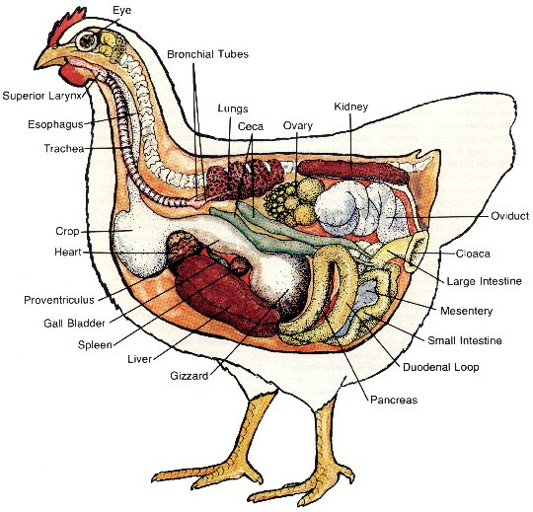
anatomy of an argument?

Slide 8
all men are mortal ← premise socrates is a man ← premise therefore, socrates is mortal ← conclusion
logical form

Slide 9
valid arguments
where the conclusion follows from the premises

Slide 10
all men are mortal ← premise socrates is a man ← premise therefore, socrates is mortal ← conclusion

Slide 11
Notice that the all of the premises are true- thus, the conclusion that follows is also true

Slide 12
all cups are green ← premise socrates is a cup ← premise therefore, socrates is green ← conclusion

Slide 13
Notice that the all of the premises are false- thus, the conclusion that follows is also false

Slide 14
invalid arguments
where the conclusion does not follow
from the premises

Slide 15
all men are mortal ← premise socrates is mortal ← premise therefore, socrates is a man ← conclusion

Slide 16
Notice that the all of the premises are true- but, the conclusion that follows is not necessarily true. Socrates could be a dog, in that, dogs are also mortal.

